Slide 1

Introduction

Slide 2
Objectives
Project Scenario and Overview
IBM Project Creation in Watson
Data Science Capstone

Slide 3



Project Scenario and Overview
The commercial space age is here, companies are making space travel affordable for everyone.
  Virgin Galactic is providing suborbital spaceflights.
  Rocket Lab is a small satellite provider.
  Blue Origin manufactures sub-orbital and orbital reusable rockets.
Perhaps the most successful is SpaceX.
Data Science Capstone

Slide 4
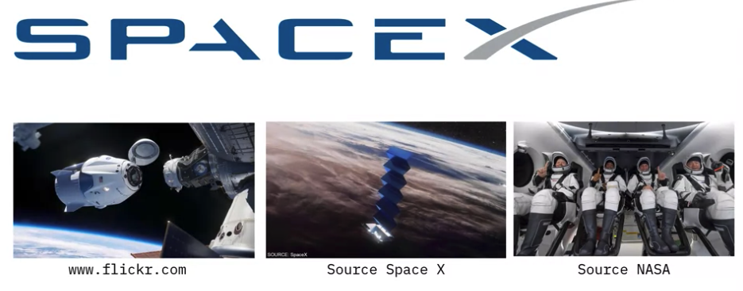
Project Scenario and Overview
SpaceX’s accomplishments include:
Sending spacecraft to the International Space Station.
Starlink, a satellite internet constellation providing satellite Internet access.
Sending manned missions to Space.
Data Science Capstone

Slide 5
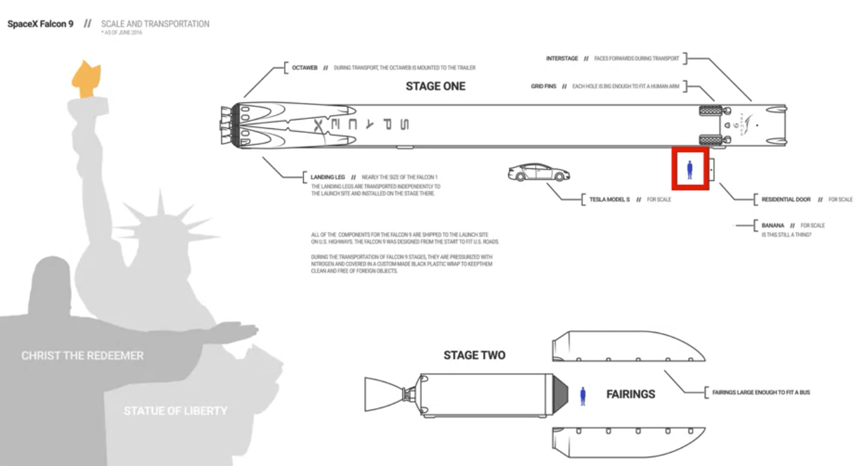
Project Scenario and Overview
Student task:
  Task: Find the reason that rocket launches of Space X are relatively inexpensive.
  Student give the answers
Data Science Capstone

Slide 6
Project Scenario and Overview
In this capstone, you will take the role of a data scientist working for a new rocket company.
Your job is to determine the price of each launch.
  You will do this by gathering information about Space X and creating dashboards for your team.
  You will also determine if SpaceX will reuse the first stage.
Instead of using rocket science to determine if the first stage will land successfully, you will train a machine learning model and use public information to predict if SpaceX will reuse the first stage.
Data Science Capstone

Slide 7
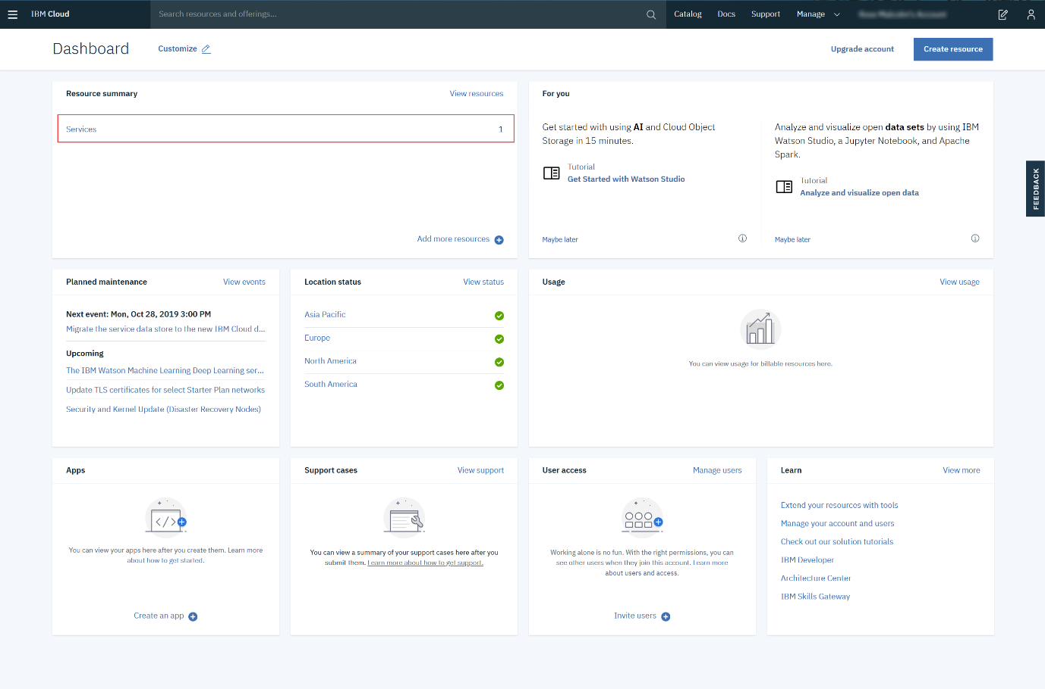
IBM Project Creation in Watson
Go to the IBM Cloud Dashboard and click Services.
Data Science Capstone

Slide 8
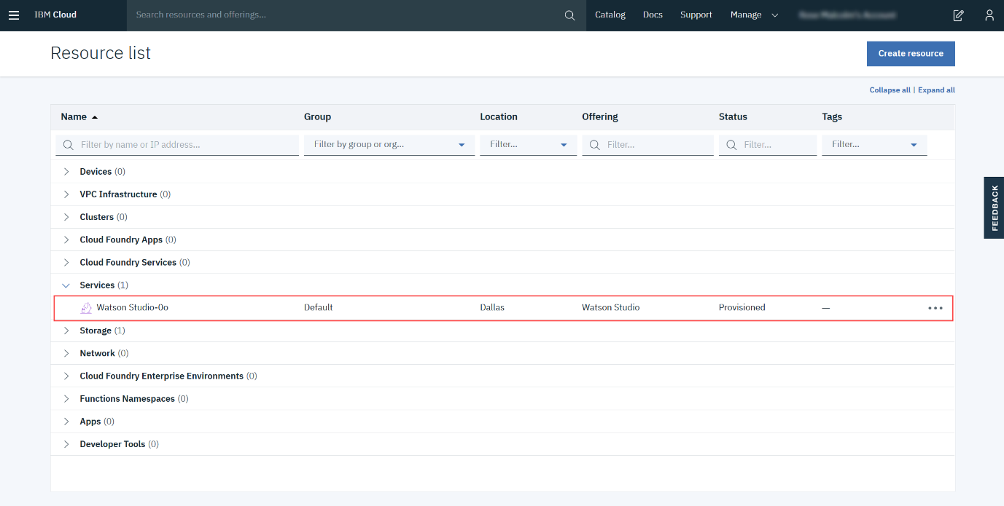
IBM Project Creation in Watson
When you click on Services, all your existing services will be shown in the list. Click the Watson Studio service you created:
Data Science Capstone

Slide 9
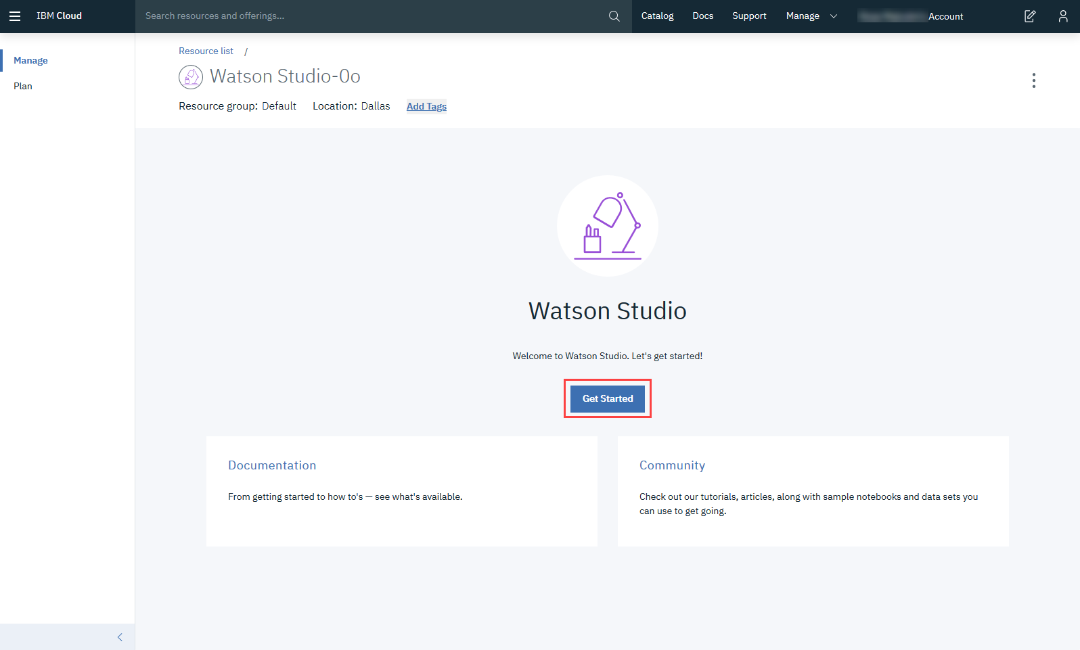
IBM Project Creation in Watson
Then click Get Started.
Data Science Capstone

Slide 10
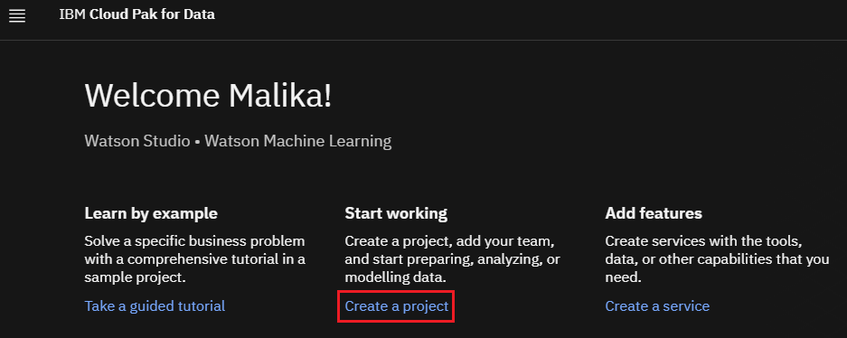
IBM Project Creation in Watson
Creating a Project: Click on Create a project:
Data Science Capstone

Slide 11
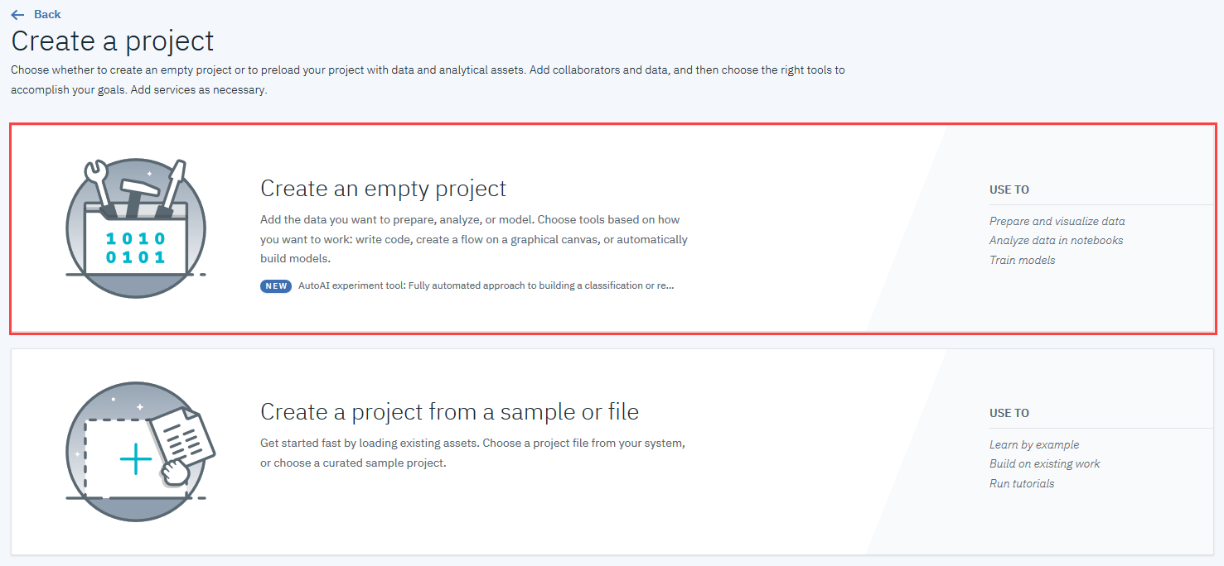
IBM Project Creation in Watson
On the Create a project page, click Create an empty project
Data Science Capstone

Slide 12
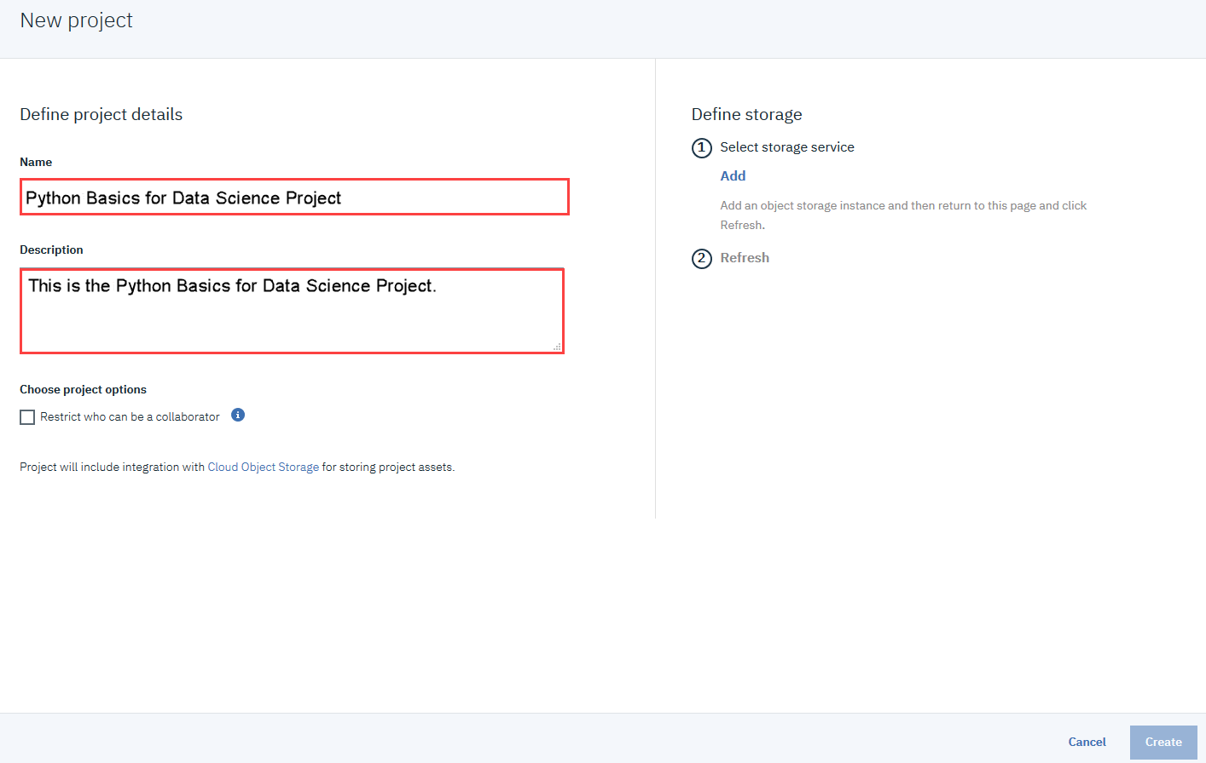
IBM Project Creation in Watson
Provide a Project Name and Description, as shown below:
Data Science Capstone

Slide 13
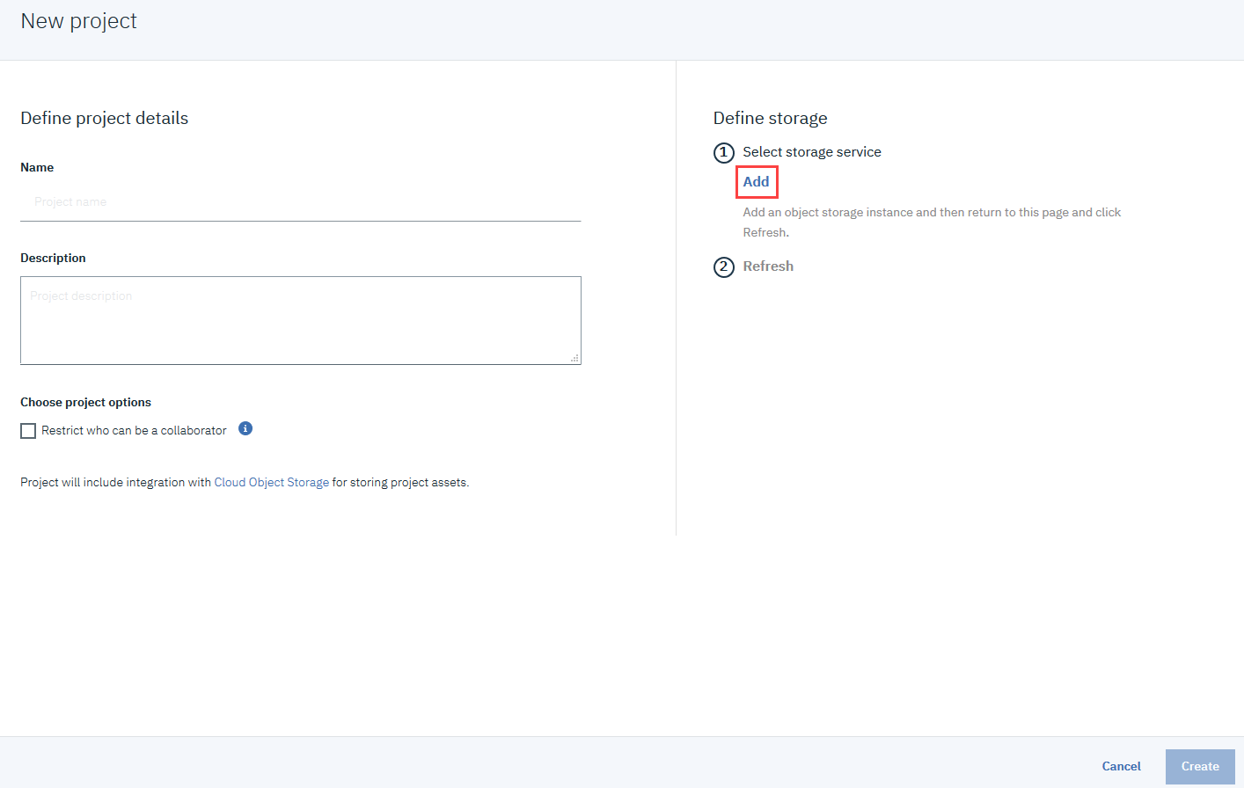
IBM Project Creation in Watson
You must also create storage for the project. Click Add
Data Science Capstone

Slide 14
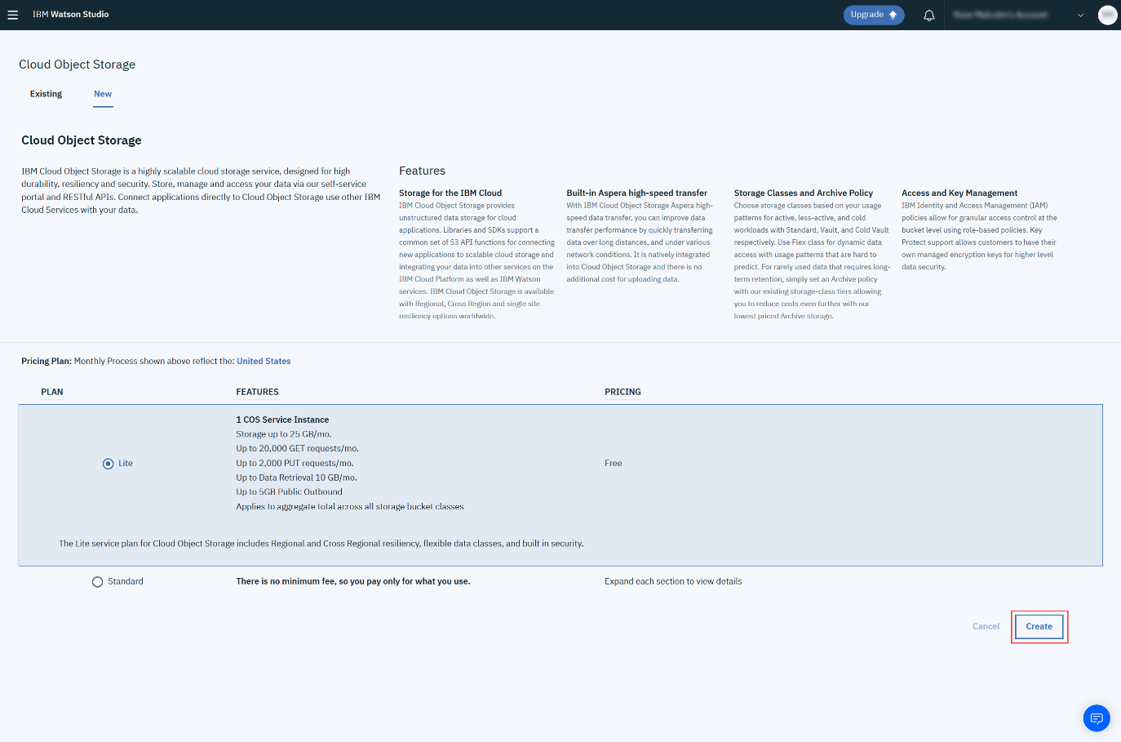
IBM Project Creation in Watson
On the Cloud Object Storage page, scroll down and then click Create.
Data Science Capstone

Slide 15
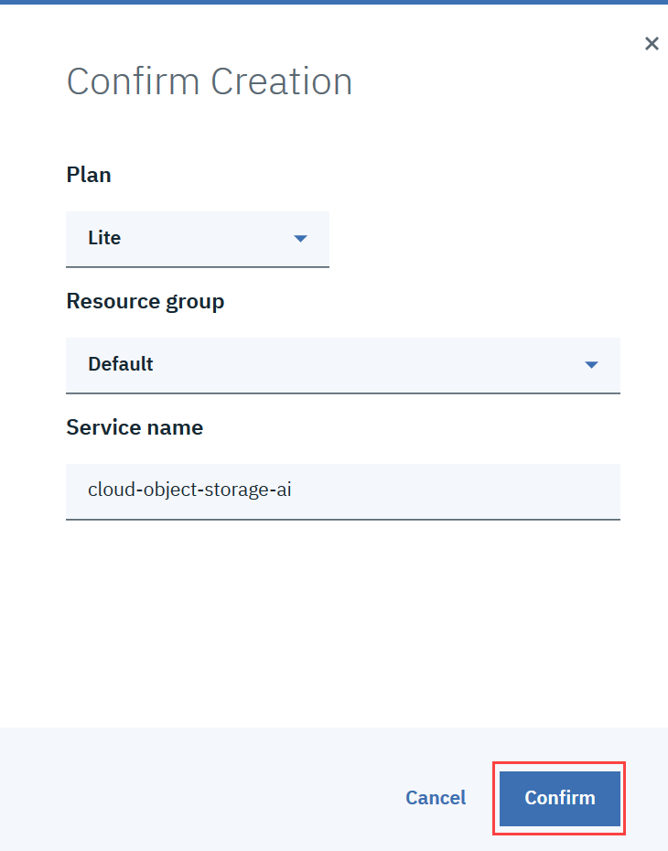
IBM Project Creation in Watson
In the Confirm Creation box, click Confirm.
Data Science Capstone

Slide 16
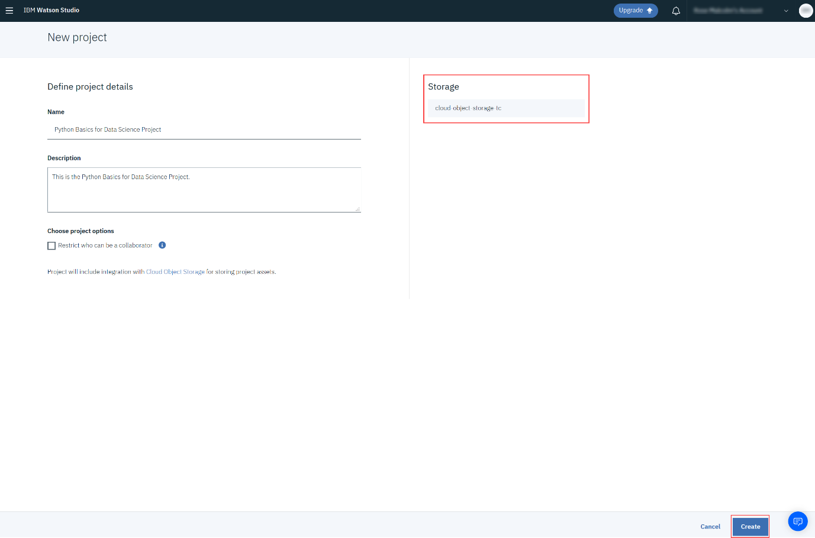
IBM Project Creation in Watson
On the New project page, note that the storage has been added, and then click Create.
Data Science Capstone

Slide 17
Summary
Project Scenario and Overview
IBM Project Creation in Watson
Data Science Capstone

Slide 18
Q & A
Data Science Capstone

